Slide 1
Cloud ETL

Slide 2
Class Objectives
By the end of today’s class, you will:
Use Amazon Web Services to host data in S3 buckets.
Create and use databases in the cloud.
Define and create ETL pipelines in the cloud.

Slide 3
ETL in the Cloud

Slide 4

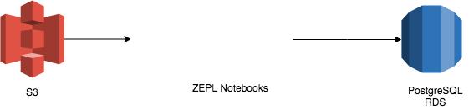
Cloud Extract
Files are stored in a cloud location such as an AWS S3 bucket.
These files are extracted from S3 and read into PySpark DataFrames using Apache ZEPL.
Files are extracted from S3 into ZEPL.

Slide 5
Cloud Transformation
Once the files are extracted into ZEPL, transformations can take place.
PySpark is used to transform the data.
ZEPL uses PySpark to perform transformations.

Slide 6
Cloud Load
After the data is transformed, ZEPL loads the data.
ZEPL creates a connection to an RDS instance and loads the DataFrame.
ZEPL loads the transformed dataset to an RDS database.

Slide 7
AWS S3

Slide 8
S3: Simple Storage Service
S3 is Amazon’s cloud file storage service.
S3 is a key-value store of objects: key is the object name, and value is the content stored.
Files are stored on multiple servers, providing redundancy.
High (> 99.99%) rate of availability guaranteed by Amazon.
Files are organized by buckets (more on this later).

Slide 9
S3 Buckets
S3 buckets are like computer folders or directories.
An S3 bucket can contain multiple files.
Unlike directories, S3 buckets must have unique names.
The bucket name is a part of the file URL.

Slide 10
S3 Settings
S3 provides fine-grained control over files, including read and write permission for buckets and files.
Read and/or write permission can be granted to individuals and/or groups.

